Slide 1

CSE 3207: Applied Statistics and Queuing Theory
Mr. Sunanda Das, Assistant Professor, Dept. of CSE, KUET

Slide 2
Statistics
The Science of collecting, organizing, analyzing, and interpreting data.
Statistics is a really important part of Data Science.

Slide 3
Applications
Identifying risk factor for a type of cancer
Predicting house price
Establish relationship between variables
Statistics help in testing the efficacy of manufacturing drugs or injections or medicines for controlling or curing certain diseases.
Decision making about marketing and finance
… … … … and many more

Slide 4
Types of Statistics
Descriptive Statistics: In this branch of statistics, the goal is to describe. There are a number of items that belong in this portion of statistics, such as:

Slide 5
The average, or measure of the center of a data set, consisting of the mean, median, mode, or midrange
The spread of a data set, which can be measured with the range or standard deviation
Overall descriptions of data such as the five number summary
Measurements such as skewness
The exploration of relationships and correlation between paired data
The presentation of statistical results in graphical form

Slide 6

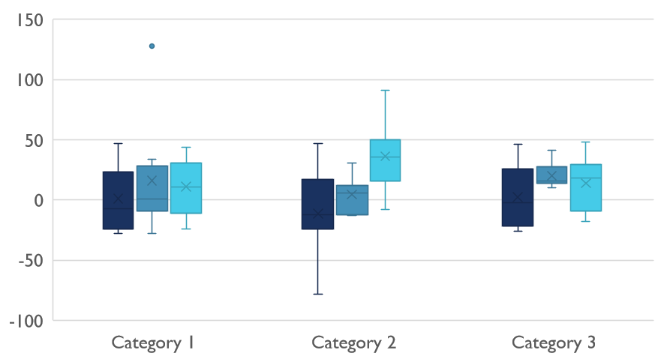
Five number summary

Slide 7
Inferential Statistics:
Inferential statistics are produced through complex mathematical calculations that allow scientists to infer trends about a larger population based on a study of a sample taken from it.
Scientists use inferential statistics to examine the relationships between variables within a sample and then make generalizations or predictions about how those variables will relate to a larger population.
It is usually impossible to examine each member of the population individually. So scientists choose a representative subset of the population, called a statistical sample.

Slide 8
Population and Sample

Slide 9
There are two main areas of inferential statistics:
Estimating parameters. This means taking a statistic from your sample data (for example the sample mean) and using it to say something about a population parameter (i.e. the population mean).
Hypothesis tests. This is where you can use sample data to answer research questions. For example, you might be interested in knowing if a new cancer drug is effective. Or if breakfast helps children perform better in schools.

Slide 10
Let’s say you have some sample data about a potential new cancer drug. You could use descriptive statistics to describe your sample, including:
Sample mean
Sample standard deviation
Making a bar chart or boxplot
Describing the shape of the sample probability distribution

Slide 11
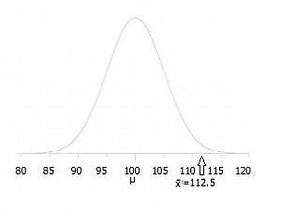
With inferential statistics you take that sample data from a small number of people and and try to determine if the data can predict whether the drug will work for everyone (i.e. the population).
There are various ways you can do this, from calculating a z-score (z-scores are a way to show where your data would lie in a normal distribution to post-hoc (advanced) testing.
A hypothesis test can show where your data is placed on a distribution like this one.

Slide 12
How Do Probability and Statistical Inference Work Together?

Slide 13
Statistical inference makes use of concepts in probability.
The sample information is made available to the analyst and, with the aid of statistical methods and elements of probability, conclusions are drawn about some feature of the population
Elements in probability allow us to draw conclusions about characteristics of hypothetical data taken from the population, based on known features of the population.

Slide 14
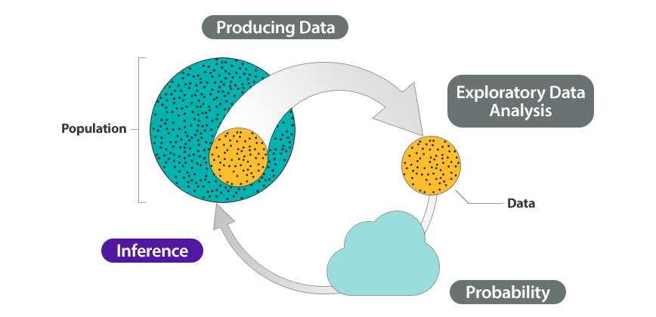

Slide 15
References
https://en.wikipedia.org/wiki/Statistics
https://www.thoughtco.com/differences-in-descriptive-and-inferential-statistics-3126224
https://www.statisticshowto.datasciencecentral.com/inferential-statistics/
https://courses.lumenlearning.com/wmopen-concepts-statistics/chapter/wim-linking-probability-to-statistical-inference/
Books:
Probability & Statistics for Engineers & Scientists by Ronald E. Walpole, Raymond H. Myers, Sharon L. Myers, Keying Ye
Probability and statistical inference by Robert V. Hogg, Elliot Tanis, Dale Zimmerman
An Introduction to Statistical Learning with Applications in R Gareth James, Daniela Witten, Trevor Hastie, Robert Tibshirani
The Elements of Statistical Learning Data Mining, Inference, and Prediction by Trevor Hastie, Robert Tibshirani, Jerome Friedman

Slide 16

Thank You

